Slide 1
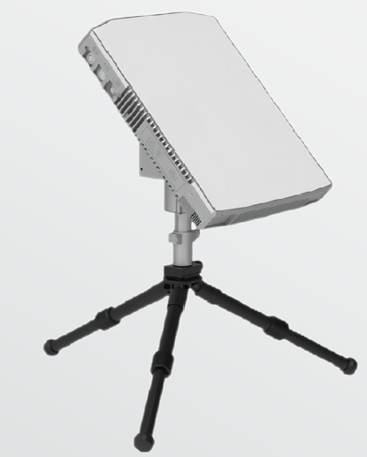
Alpha Satcom Waveguide Array Antennas
PST 0.35 & 0.6-mtr Ku-band
Portable Satcom Terminals
September 2022

Slide 2
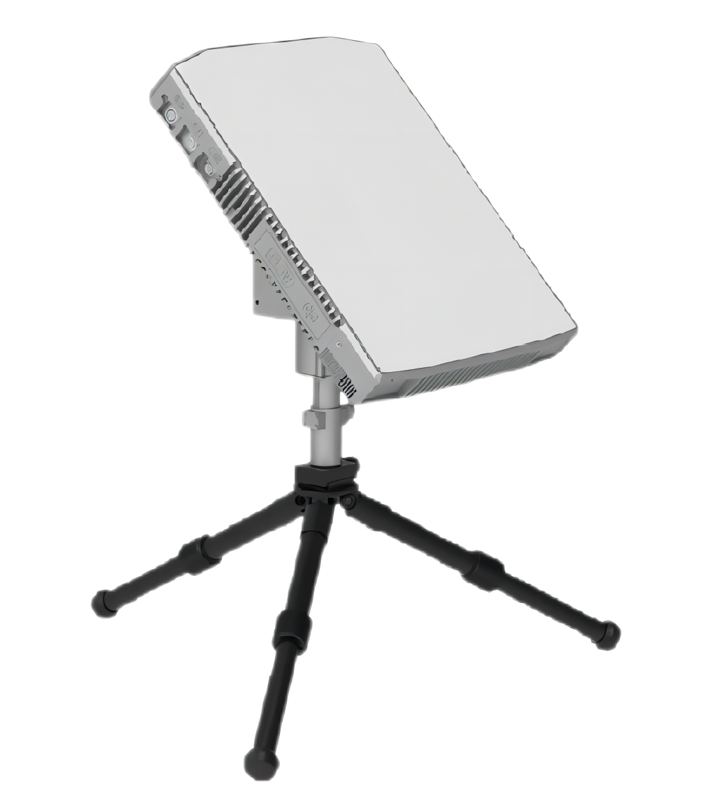

PST 0.35 & 0.6-mtr Ku-band Portable Satcom Terminals
The fully integrated, waveguide array antenna, is a compact design with LNB , BUC, Control board, Satellite Modem, Wireless Access Point and Battery contained in a single lightweight package.
Ultra Light and easily transportable, the Manual configuration weight is less than 8 kg, and the Auto-Pointing model is less than 12 kg.
After connecting with the antennas’ WiFi via a handheld device (IOS or Android) the GUI interface provides precise pointing to the satellite of interest.
Therefore the setup is a quick and easy operation, which is performed within 3 minutes by a single person without any tools.
Transport packaging is provided with a high strength, light weight aluminum-magnesium alloy case.

Slide 3
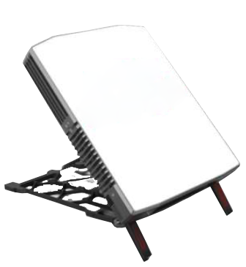
PST .035 & 0.6-mtr Ku-band Portable Satcom Terminals
The ultra-light terminals are all-inclusive with built-in wireless design integrated with a satellite modem, WiFi Access Point, LNB/BUC, control logic board and battery.
The modem agnostic units currently have integrated devices such as iDirect and Gilat DVB/RCS modems.
The units are presently being used in emergency, public security, fire protection, meteorology, civil air defense, aerospace and military. industries.

Slide 4
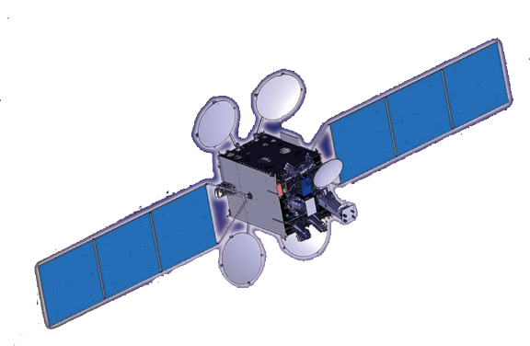


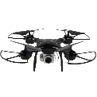









End-To-End Operational and Connectivity Overview
基站
BTS
0.35m Ku-band Terminal
HTS
VoIP Gateway
Drone
Mobile
Video surveilance
Video conference
phone Fax
Streaming media distribution terminal
Internet
Stream Media
Gateway

Slide 5
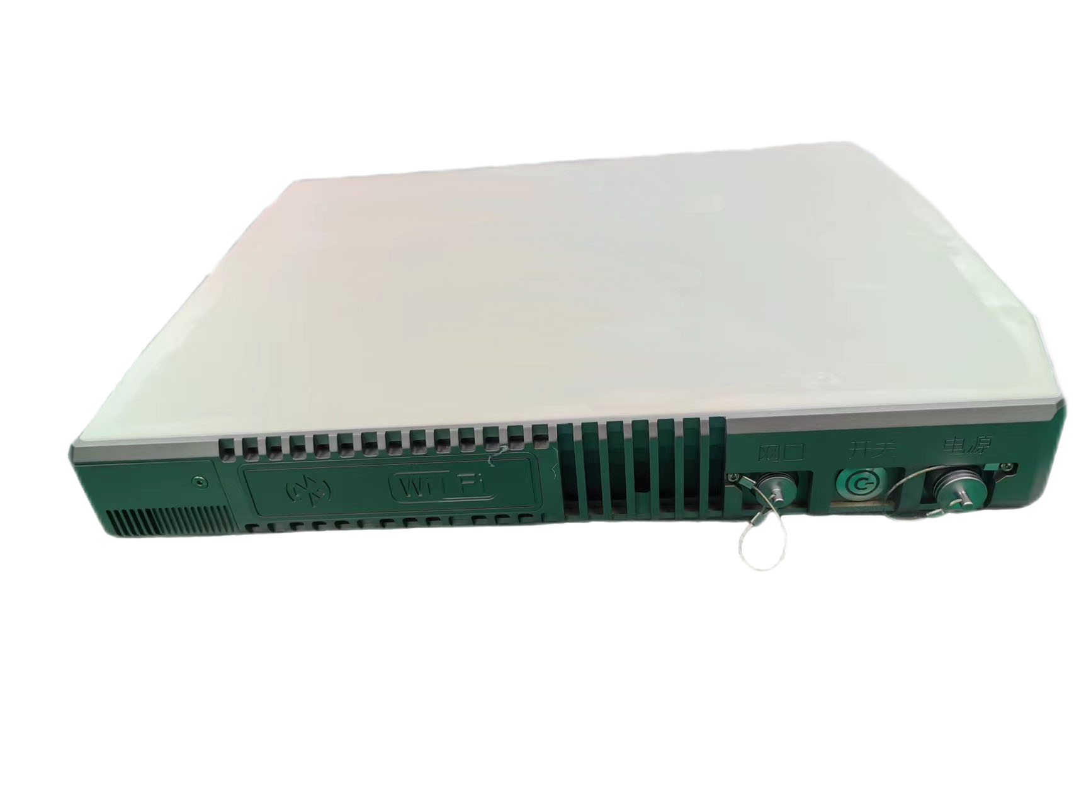
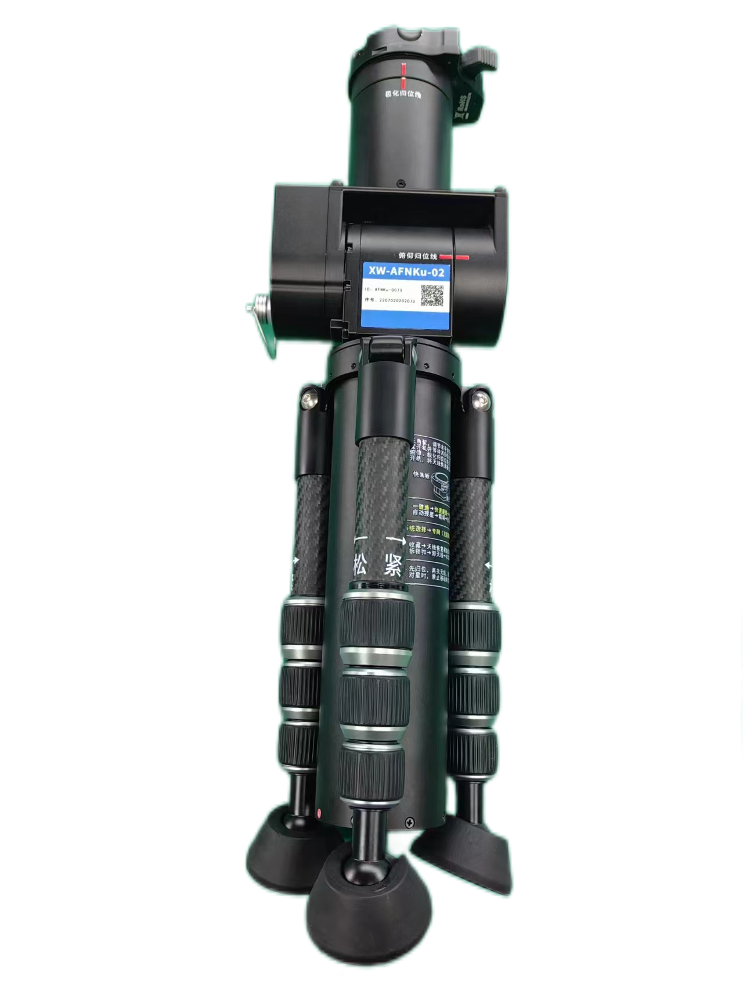
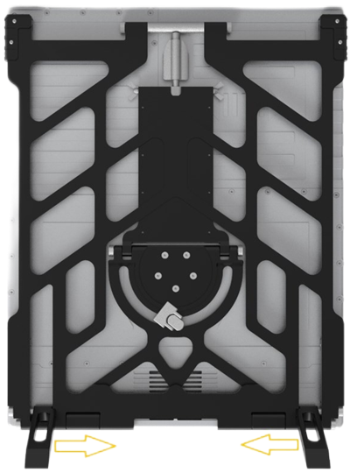
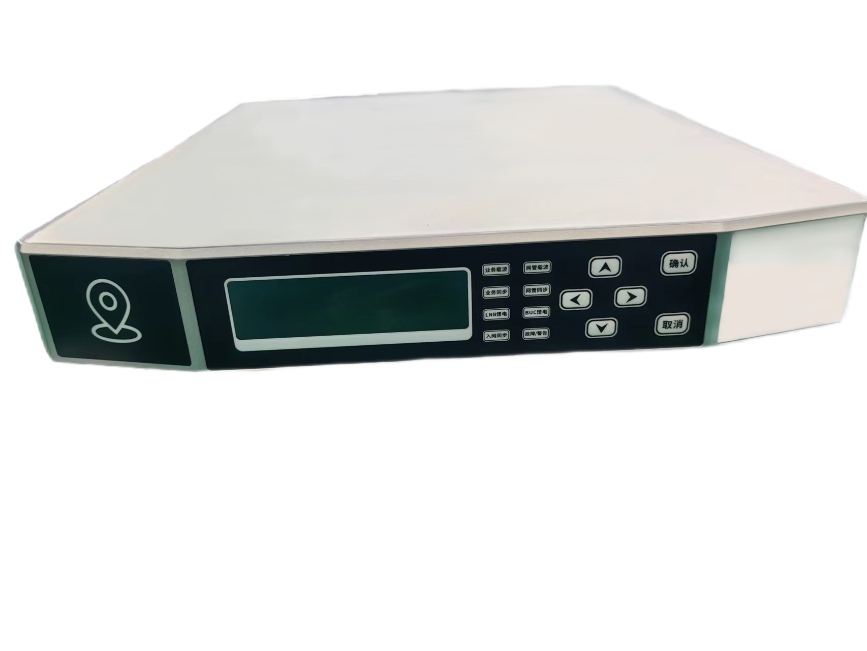
0.35-mtr Manual Ku-band terminal

Slide 6

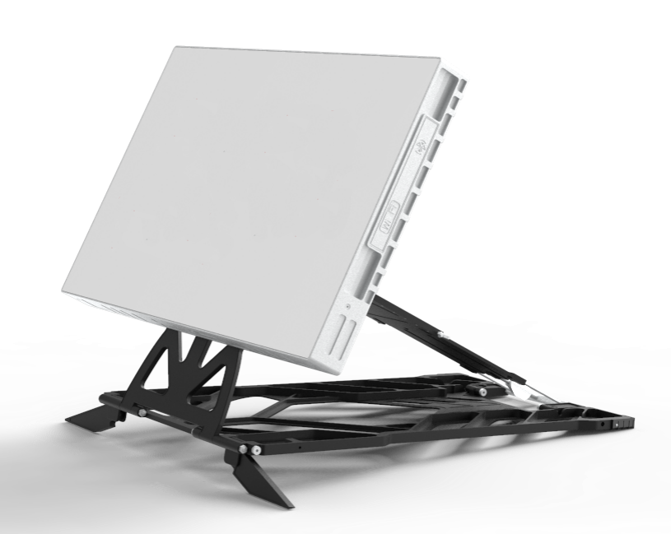
PST 0.35 & 0.6-mtr Ku-band
Portable Satcom Terminals
0.35m Satcom Terminal
0.6m Satcom Terminal
Manual Auto Pointing
Manual Auto Pointing

Slide 7
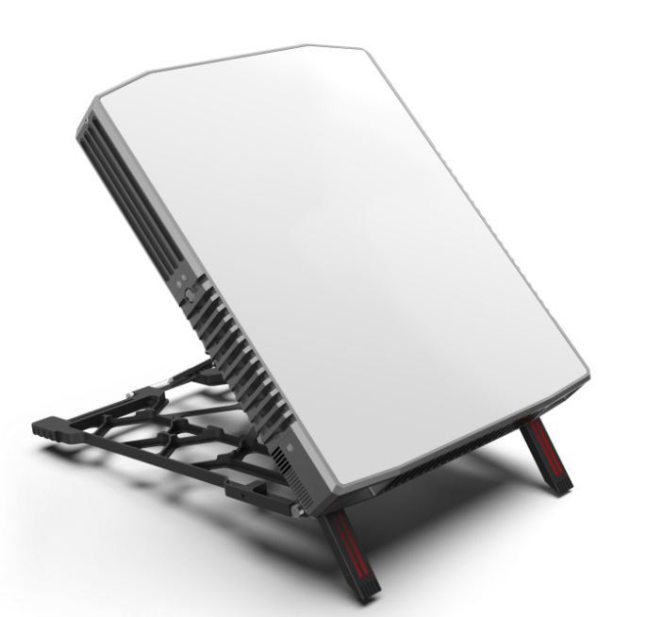
PST 0.35-mtr Ku-band Models
Manual Type
Auto Pointing Type

Slide 8
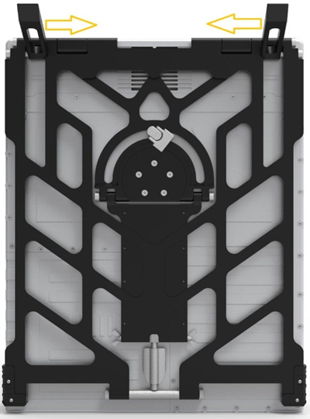
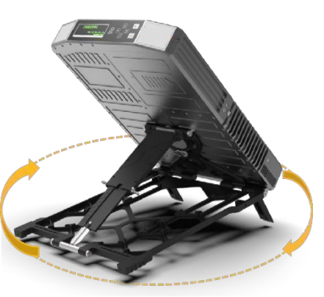
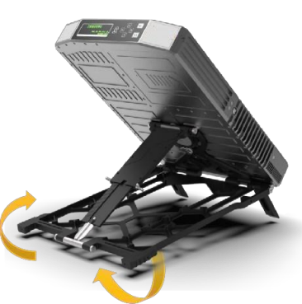
Manual Configuration with WiFi Pointing Application

Slide 9
Specifications of PST 0.35-mtr Antenna
Size | ≤L385mm*W315mm*H60mm | Weight | ≤6Kg(Manual） ≤8kg(Auto）
Input Power | 29.4V | Power Consumption | 110W
TX Freq Range | 14.0-14.5GHz | TX Gain | ≥32.5dBi
RX Freq Range | 10.7-12.75GHz | RX Gain | ≥31.5dBi
Pol | Linear | X-Pol Isolation | ≥30dB
G.T | ≥11dB/K | Equivalent aperture | ≥0.35m
Type | Waveguide Array Antenna | Max Power/EIRP | 16W/42dBm
Setup time | ≤3min | Satellite Acquisition | Manual/Auto Pointing
Battery Operation Time | ≥1.5 Hours
Protection Level | ≥IP67
Altitude | ≥7200m

Slide 10
PST 0.6-mtr Ku-band
Portable Satcom Terminal
Manual Type
Auto Pointing Type

Slide 11
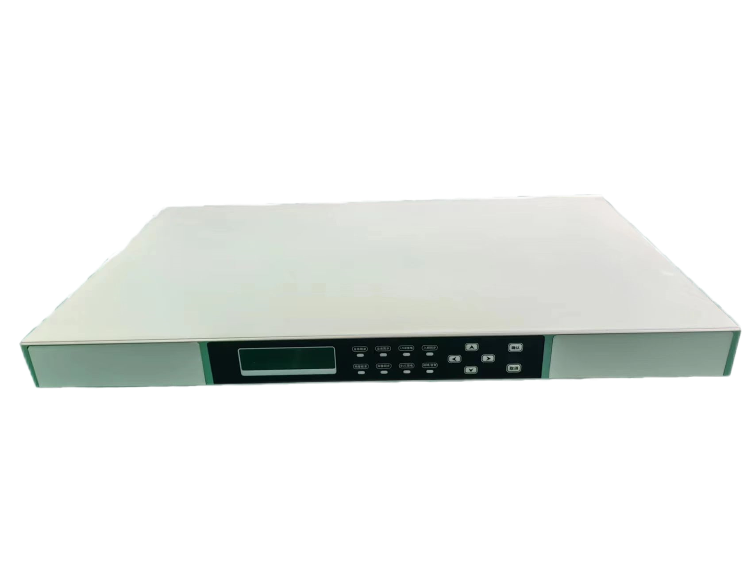
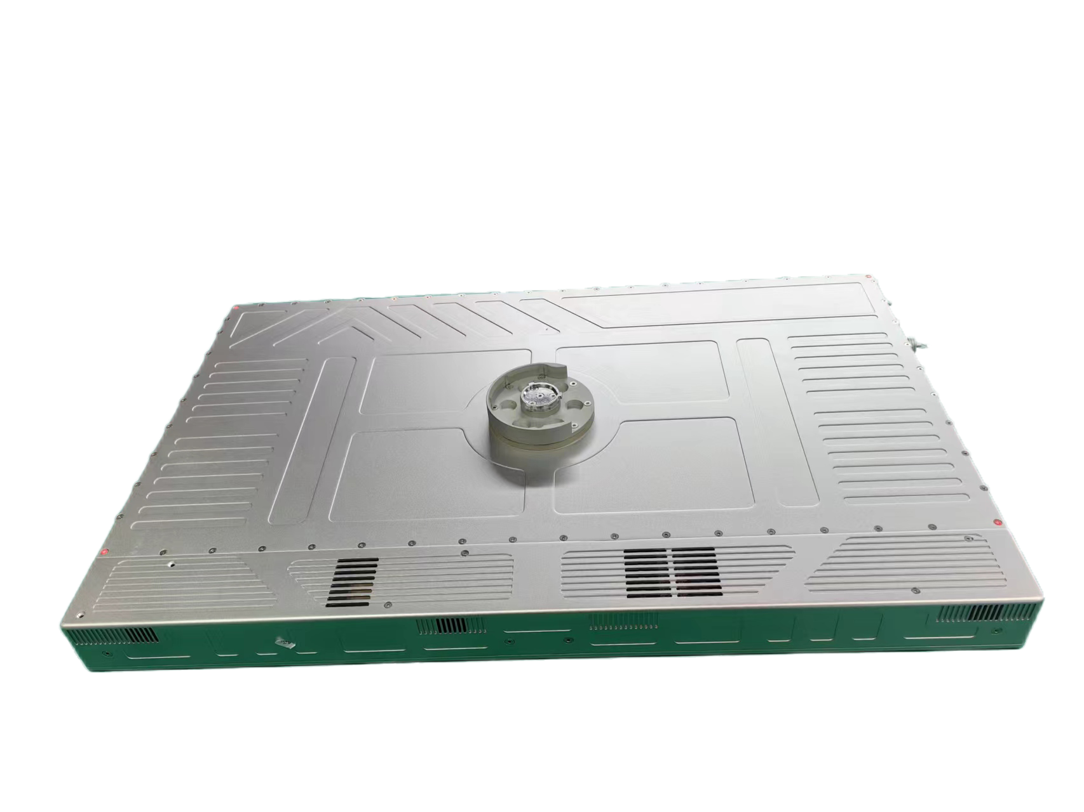
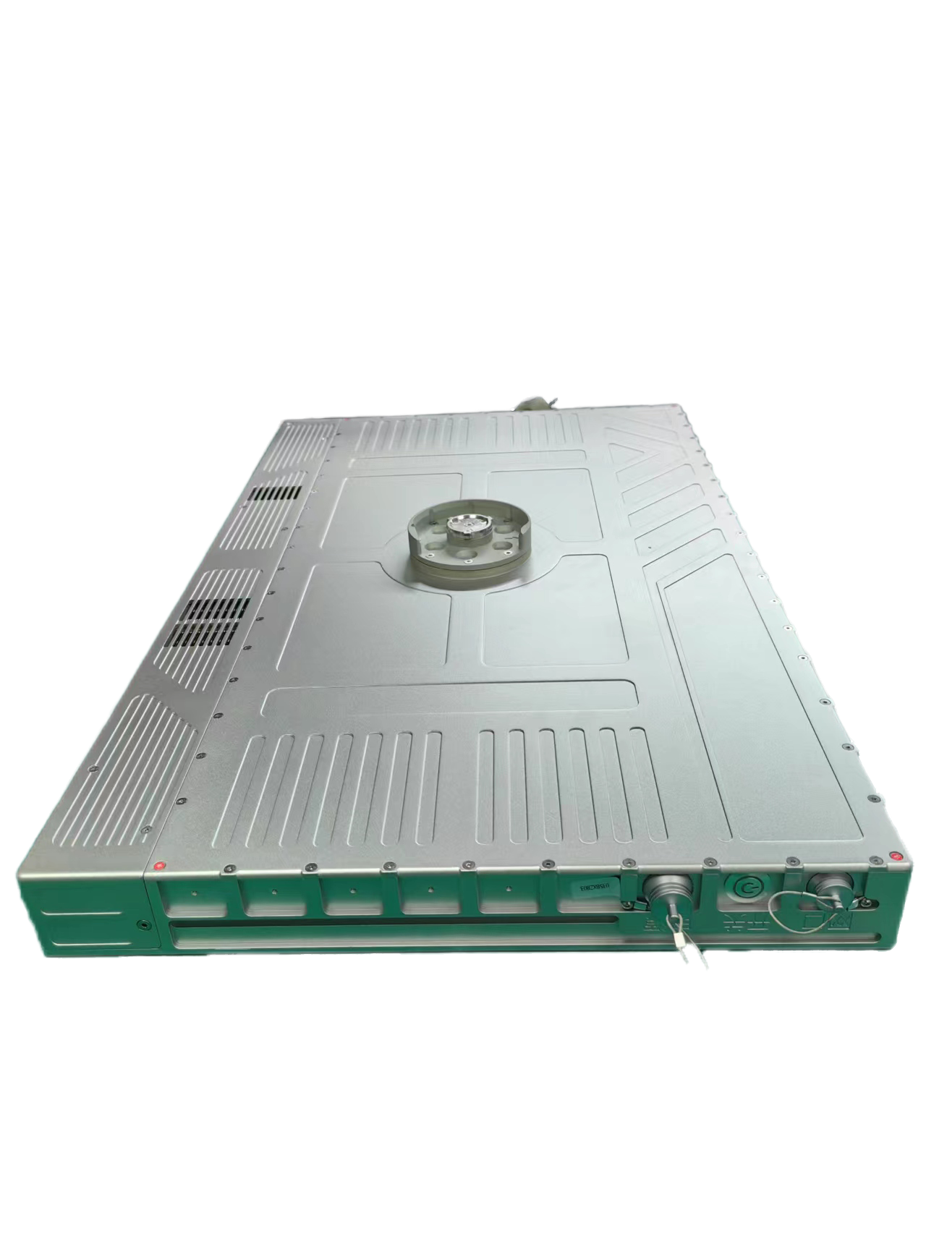
PST 0.6-mtr Auto Pointing Ku-band terminal

Slide 12
Specification of PST 0.6-mtr Antenna
Size | ≤ 95mm*370mm*60mm | Weight | ≤10kg (Manual） ≤12kg (Auto）
Input Power | 29.4V | Power Consumption | 110W
TX Freq Range | 14.0-14.5GHz | TX Gain | ≥36.8dBi
RX Freq Range | 10.7-12.75GHz | RX Gain | ≥35.6dBi
Pol | Linear | X-Pol Isolation | ≥30dB
G.T | ≥13dB/K | Equivalent aperture | ≥0.6m
Type | Waveguide Array Antenna | Max Power/EIRP | 16W/42dBm
Setup time | ≤3min | Satelllite Acquisition | Manual/Auto-pointing
Battery Operation Time | ≥ 2.5Hours
Protection Level | ≥ IP67
Altitude | ≥ 7200m

Slide 13
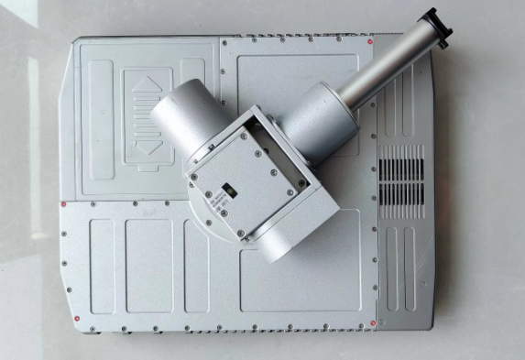
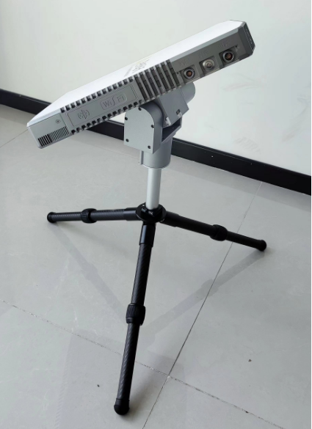
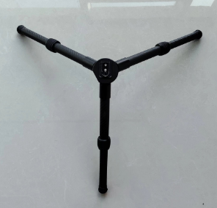
Auto-Pointing Pedestal

Slide 14
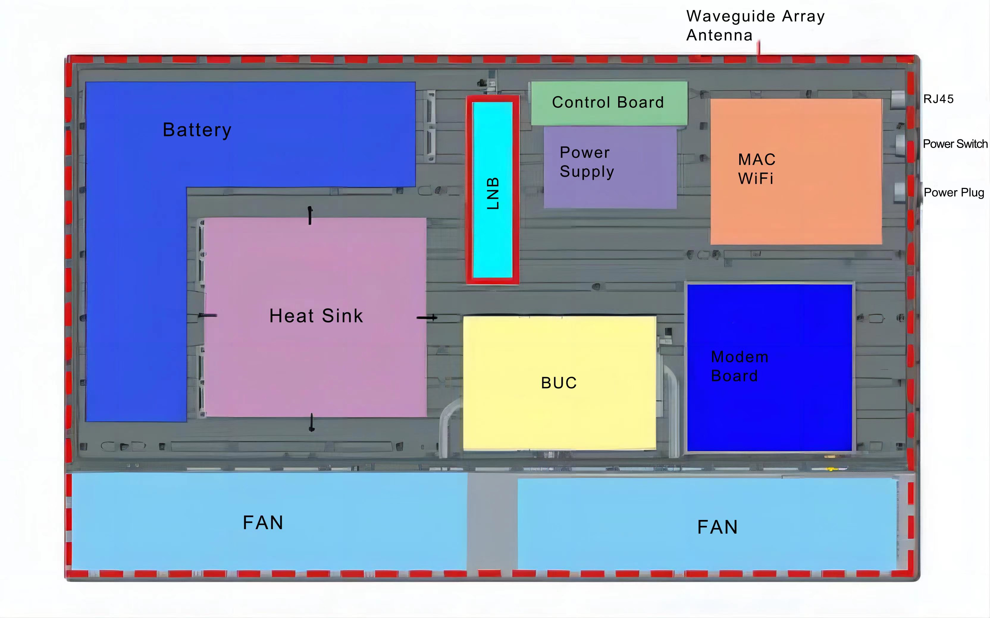
Antenna Block Diagram and Layout
Waveguide Array Antenna
LNB
BUC
Battery
Modem card
Control Board
Power Supply
M&C
WIFI
User Interface

Slide 15
Internal Space Available for Built-in Modem Card
BUC size：
Available 4W，8W，16W (in standard case) .
MAX 20-25W (larger cases)
Current Integrated Modem Types：
iDirect IQ200 modem card；
Gilat modem card；
Other satellite system modem cards can be integrated.
Max spaces for other modem cards
0.35-mtr antenna ：146*165*20 mm （W*L*H)
0.5 & 0.6-mtr Antenna ：292*330*40 mm

Slide 16
Packing Weights & Dimensions
0.35m Antenna：49X41X37CM
Manual Type：
Net weight ≤6Kg；Gross weight: 10KG
Auto Type：
Net weight ≤8Kg；Gross weight: 12KG
0.6m Antenna: 65X35X45CM
Manual Type：
Net weight 8Kg；Gross weight：12.5KG
Auto Pointing Antenna：
  2 Boxes
  Box1：65X35X45CM
Box2：53X25X20.5CM
Net weight 12Kg； Gross Weight：17KG

Slide 17


Backpack Configurations
PST 0.35-mtr Backpack
PST 0.6-mtr
Backpack

Slide 18
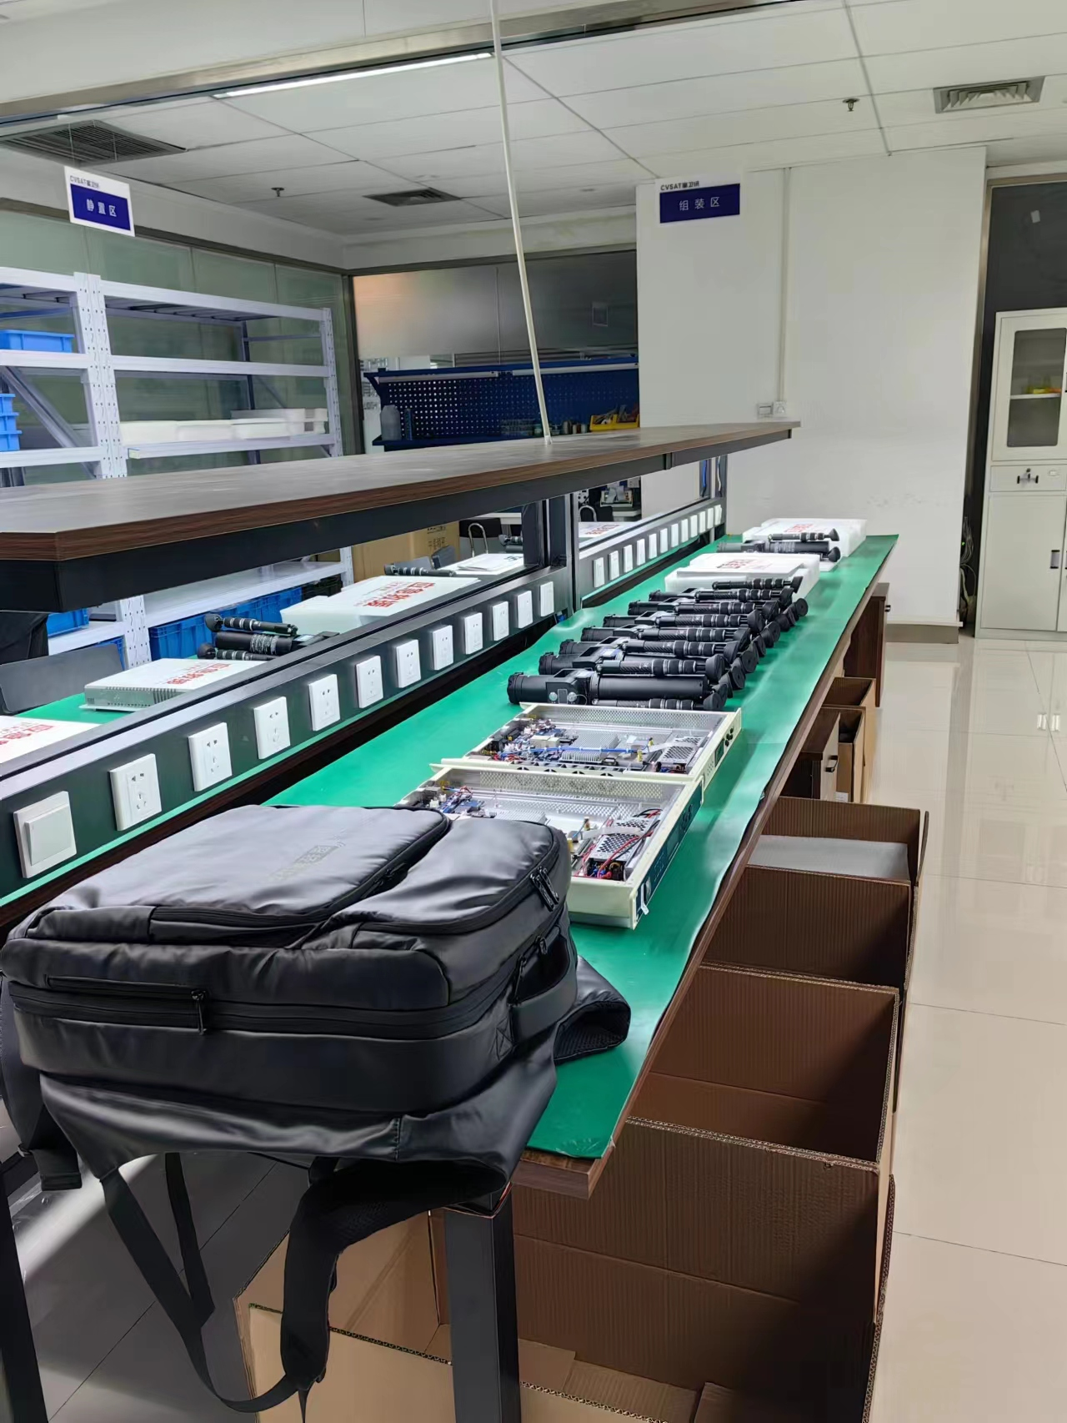
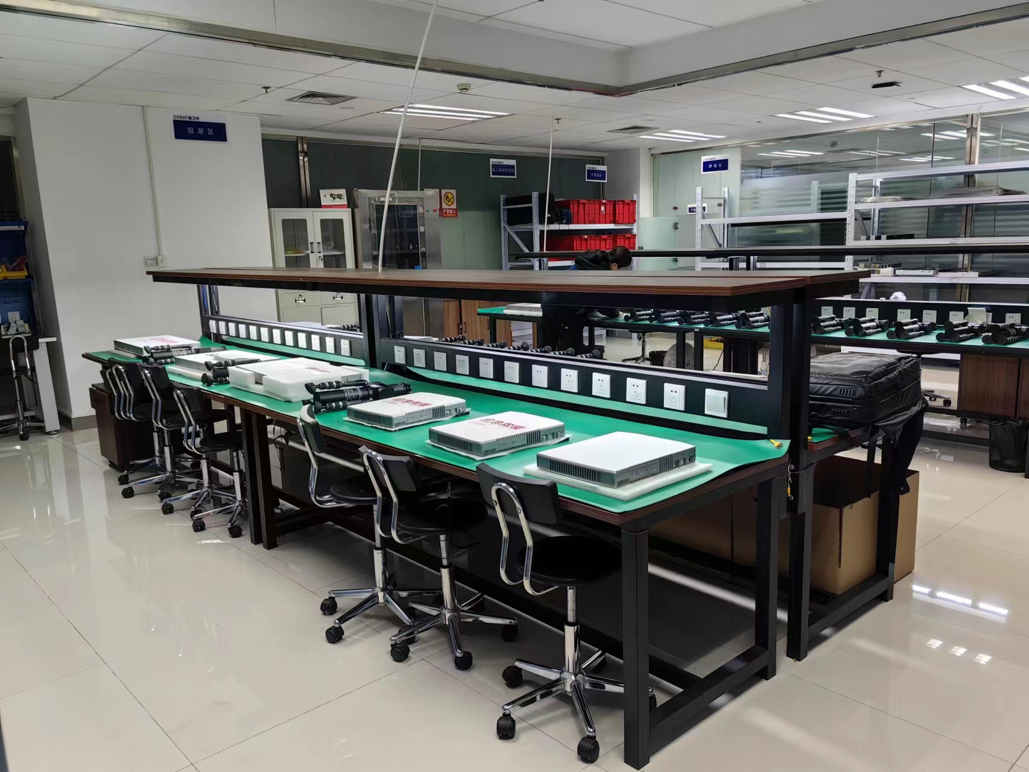
Factory Staff & Production Capacity
Capacity production rate is, 100sets/month
Highly trained Engineering and Technical staff
Two production lines.
300 sets of test equipment

Slide 19
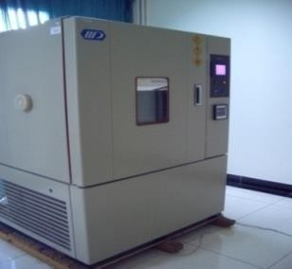
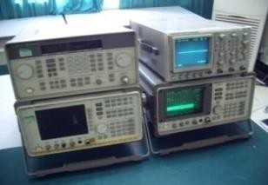
Antenna Laboratory Test Equipment

Slide 20
Product History
2017, Delivery of the first portable terminal, Ku-band Narrow band.
2019, Antenna Feeds were upgraded to operate at Wide Ku-band.
2021, Automatic pointing capability was added.
Audio pointing function for the manual system was added.
To date, more than 1000 Ku-band units have been delivered to emergency, public
security, fire protection, power grid, forest fire protection, and other critical
national and industrial organizations.
Currently manufacturing 100 sets of 0.5-mtr Ka-band system for a National
Satellite Operator.

