Slide 1
7.3-Mtr Ka-band Turning Head antenna
Ka-Band Gateway Option

Slide 2
Ka-Band Gateway antenna
Antenna Size | Tracking Method | Drive Method
≤ 9.0-Mtr for Commercial Applications | Step Track with Predicative Tracking | Self-locking mechanical screw jacks
≥ 9.0-Mtr for TT&C, IOT, Special Applications | Monopulse Tracking | AZ: Single motor dual pinion or dual motors EL: Self-locking mechanical screw jacks

Slide 3
Tracking Error
Track Type | Beamwidth Tracking Capability
Step Track | 10% 3dB Beamwidth
Predicative Track | 5% 3dB Beamwidth
Monopulse Track | 3% 3dB Beamwidth

Slide 4
Existing lma antenna tracking error
Size | Rx 3dB | Tx 3dB | Drive Radius | Backlash | Loss dB
7.3M | 0.15° | 0.11° | 1542 mm | 0.0074° | 0.14
9.0M | 0.12° | 0.09° | 1727 mm | 0.0066° | 0.15
13.2M | 0.08° | 0.06° | 2194 mm | 0.0052° | 0.17
Mechanical Screw Backlash : 0.1 – 0.2mm (0.008”)
Eutelsat Test Report for UAN Ka-Band Gateway for LMA 9.0M Antenna Smart-Step track is available.

Slide 5
THA Antenna tracking analysis
Jackscrew Backlash : 0.1 – 0.2mm (0.008”)
Size | Rx 3dB | Tx 3dB | Drive Radius | Backlash | Loss dB
7.3THA | 0.15° | 0.11° | 1000 mm | 0.0115° | 0.21
7.3THA | 0.15° | 0.11° | 1400 mm | 0.0082° | 0.025

Slide 6
Rain fade and redundancy
All Satcom systems work within the bandwidth limit in clear skies.
Typical Uplink Power Control Range < 10dB
Rain Fade
      Cloudy : > 3-5dB
      Rainy : > 20dB

Slide 7
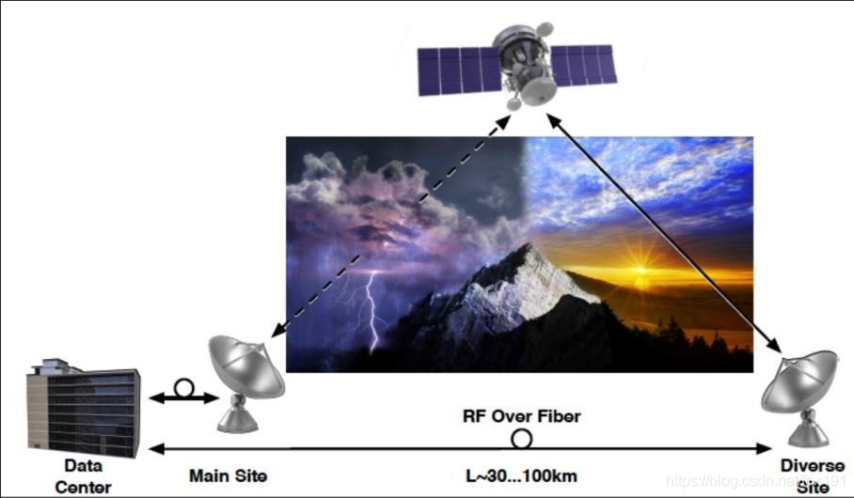
Diversity back up
Ka-Band Application
Data Center Primary Site L ≥ 25 KM Diversity Site

Slide 8
Ka-band gateway
7.3M Ka-Band Antenna with Step Track controller and Diversity backup site.
Reasonable cost and highest reliability solution.

Slide 9
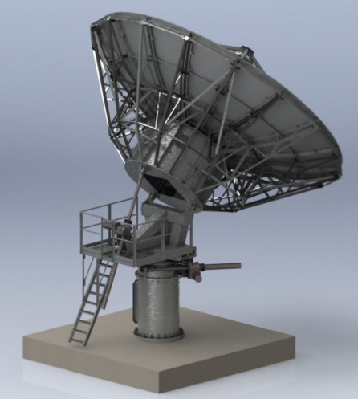
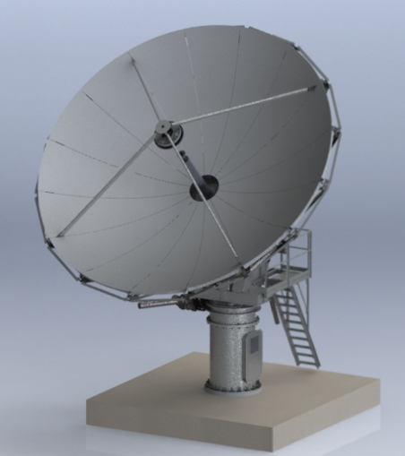
Turning Head Antenna
Manually repositionable 6.2-Mtr & 7.3-Mtr Turning Head Antennas (THA) with Azimuth slew gear and repositionable Azimuth jack attachment.

Slide 10
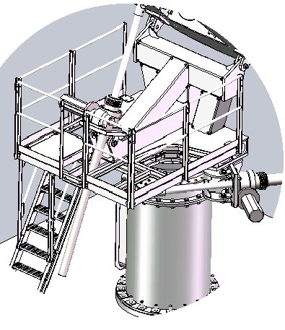
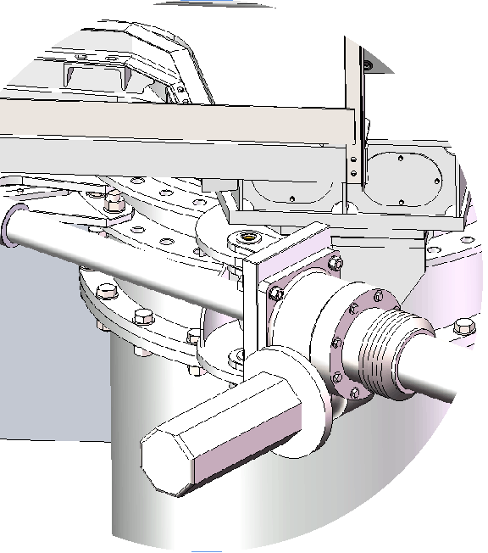
Benefits of a turning head antenna
Cost effective AZ & El drives, complete with fail-safe, self-locking, mechanical screws and anti-backlash adjustments.
Adjustable backlash capability within 0.1 – 0.2mm (0.008”), ensuring necessary tracking capability at Ka-Band.
EL Travel : 0 to 90°
AZ Travel : 0 +/- 180°
Three (3) 60° Segments

Slide 11
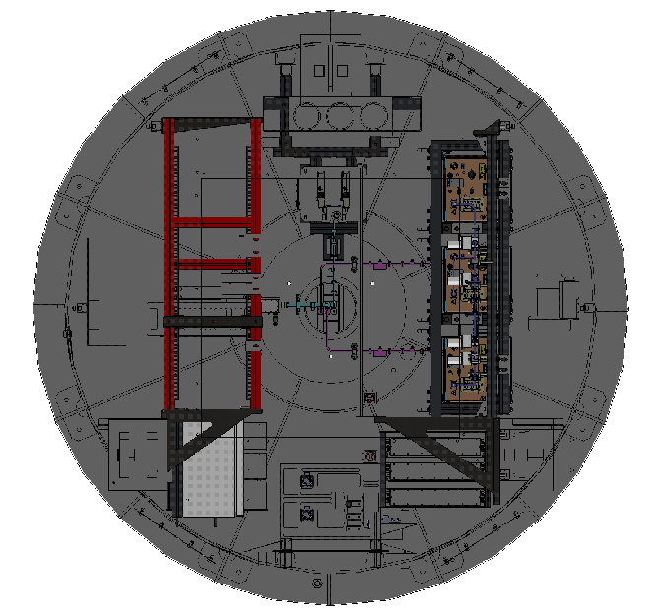
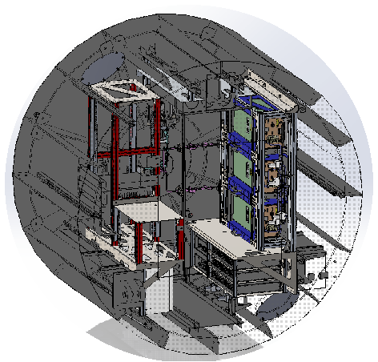
2.0-Mtr x 1.4-Mtr diameter insulated Hub.
Generous volume available for installation of Ka-Band RF components.
Waveguide system/rack is integrated and designed in accordance with customer specified RF equipment.

Slide 12
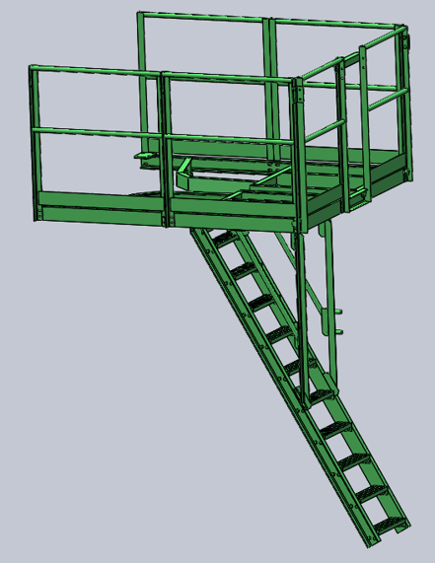
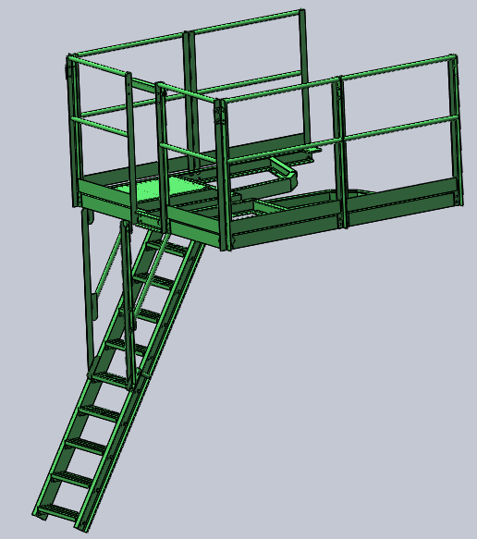
Ladders & Platform
Ladder and Platform are provided for safety and ease of maintenance.
Expanded Platform for mounting AC units are not shown.

Slide 13
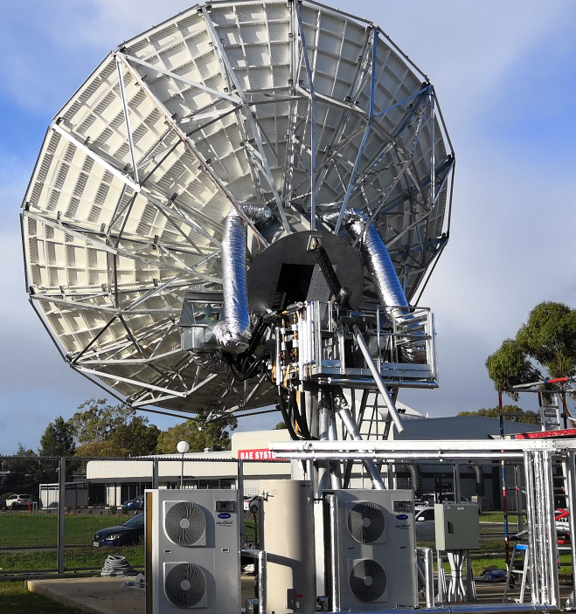
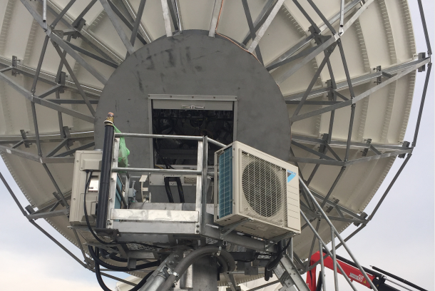
Hub
Every Ka-Band insulated Hub is provided with a rolling door and four openings for air circulation.
Heat dissipation is achieved by 1:1 air conditioners, mounted on the expanded platform, or from the introduction of high volume of outside air.
Type of air circulation is dependent on both the location and environmental site conditions and/ or the customer’s requirements.

Slide 14
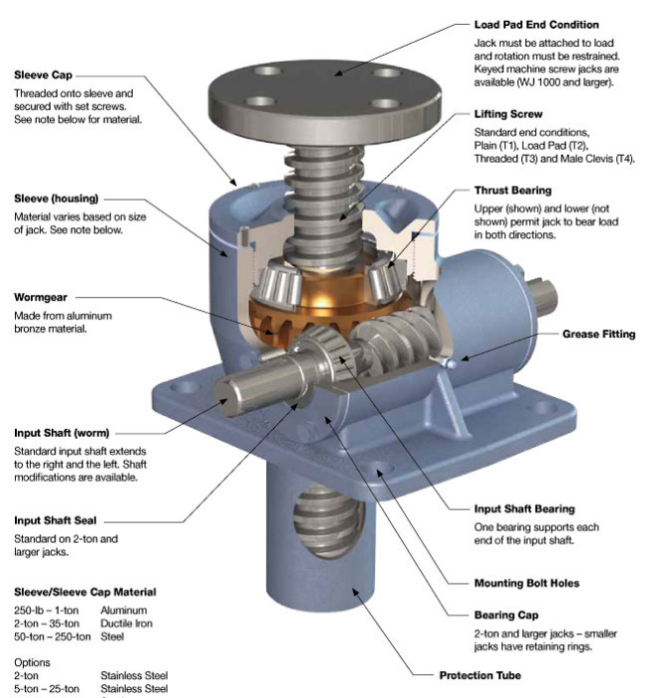
Jack systems
Industry proven jack systems are utilized on all of our antennas.
All jack systems’ designs and manufacturing material have been utilized throughout our industry for decades.
All manufactured parts pass strict inspections, ensuring a quality product.
0.1 – 0.2mm (0.008”) adjustment of backlash is available.

Slide 15
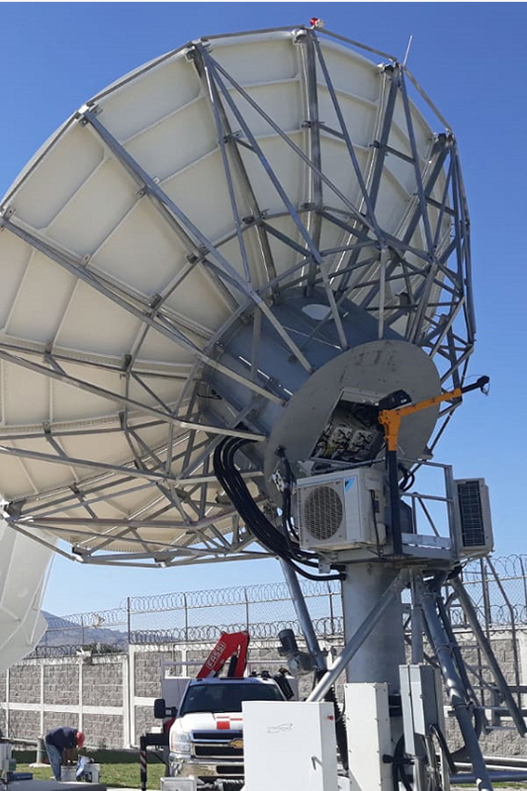
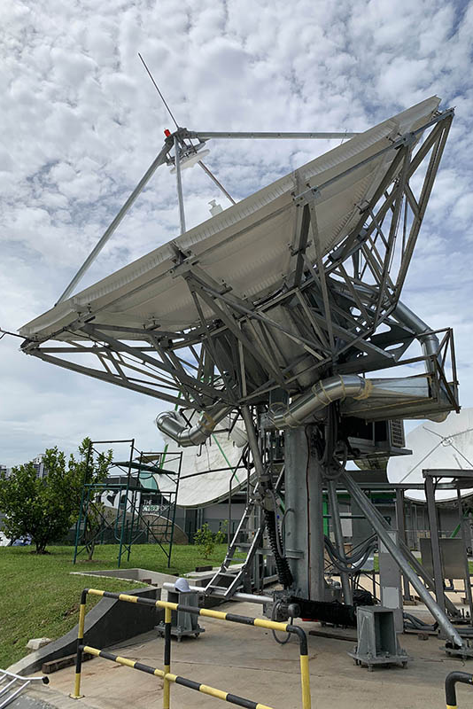
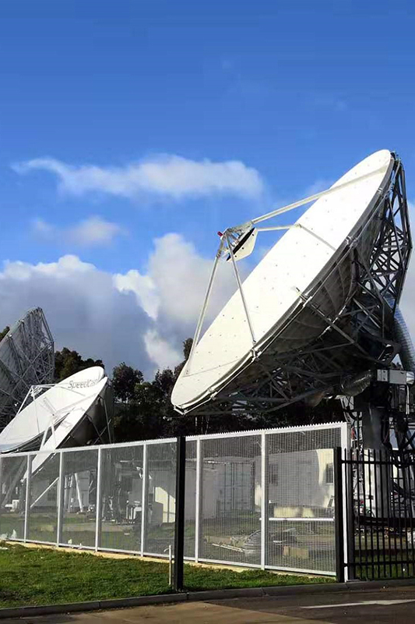
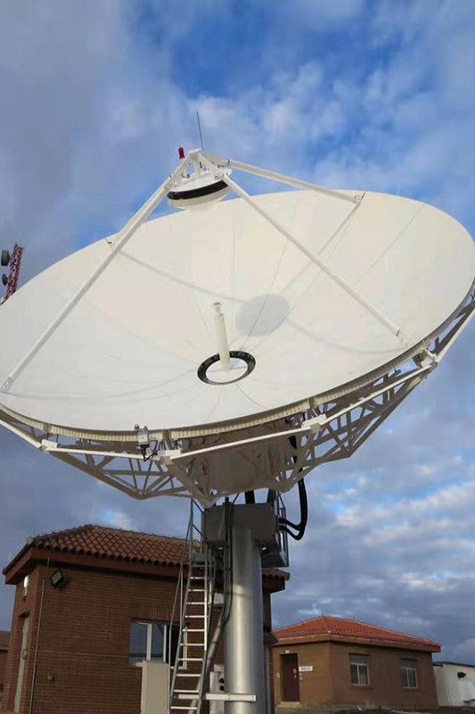
ALPHA Antennas

